Slide 1
North American Regional-Scale Flux Estimation and Observing System Design for the NASA Carbon Monitoring System
NOAA/CIRES: Arlyn Andrews, Kirk Thoning, Michael Trudeau
AER, Inc.: Marikate Mountain, Thomas Nehrkorn, Janusz Eluszkiewicz
Carnegie Institution for Science / Stanford University: Anna Michalak, Vineet Yadav
Earth Networks: Chris Sloop
Colorado State University: Chris O’Dell

Slide 2
CarbonTracker-Lagrange: A new tool for regional- to continental-scale flux estimation
  New Lagrangian inverse-modeling framework under development at NOAA Earth System Research Laboratory in collaboration with many partners to take advantage from measurements and datasets developed under the North American Carbon Program.
  Initial support from NOAA Climate Program Office’s Atmospheric Chemistry, Carbon Cycle, & Climate (AC⁴) Program. NASA Carbon Monitoring System funding has enabled inclusion of satellite and TCCON data.
  High-resolution WRF-STILT atmospheric transport model customized for Lagrangian simulations (Nehrkorn et al., Meteorol. Atmos. Phys., 107, 2010). AER, Inc. is responsible for STILT-WRF runs. Also testing HYSPLIT-NAM, HYSPLIT-HRRR and HYSPLIT-HRRR (High Resolution Rapid Refresh, an experimental real time 3-km simulation from NOAA-ESRL).
  Pre-computed footprints combined with efficient matrix inversion code enables testing of many variants of inversion.

Slide 3
CarbonTracker –Lagrange Contributors
  Modeling team:
    NOAA & CIRES: A. Andrews, K. Thoning, M. Trudeau, J. Miller, K. Masarie, R. Draxler, A. Stein, L. Hu
    AER, Inc.: M. Mountain, T. Nehrkorn, J. Eluszkiewicz
    Carnegie Institution for Science/Stanford: A. Michalak, V. Yadav, M. Qui
    Colorado State University: C. O’Dell
    Harvard University: S. Wofsy, S. Miller, J. Benmergui
  Data Providers:
    NOAA Earth System Research Laboratory’s Global Monitoring Division
    Environment Canada (D. Worthy)
    Penn State University (K. Davis, S. Richardson, N. Miles)
    NCAR (B. Stephens)
    Oregon State University (B. Law, A. Schmidt)
    Lawrence Berkeley National Lab (M. Torn, S. Biraud, M. Fischer)
    Earth Networks (C. Sloop)
    Harvard University (S. Wofsy, J. W. Munger)
    U of Minnesota (T. Griffis)
    TCCON team; CalTech (D. Wunch, P. Wennberg; S. Newman) & JPL (G. Toon)
    GOSAT-ACOS team
    OCO-2 team

Slide 4

Recent studies have demonstrated the usefulness of regional Lagrangian inverse modeling for greenhouse gas flux estimation:

Slide 5
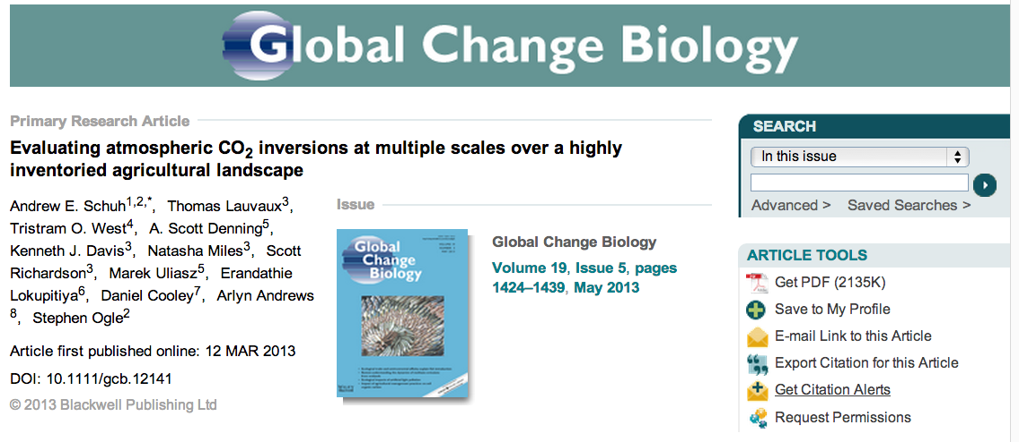
Recent studies have demonstrated the usefulness of regional Lagrangian inverse modeling for greenhouse gas flux estimation:

Slide 6
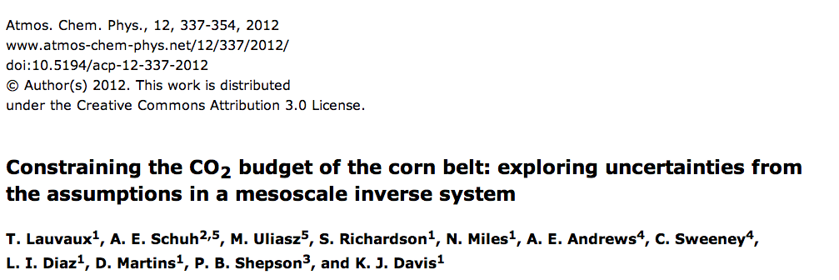

Recent studies have demonstrated the usefulness of regional Lagrangian inverse modeling for greenhouse gas flux estimation:

Slide 7
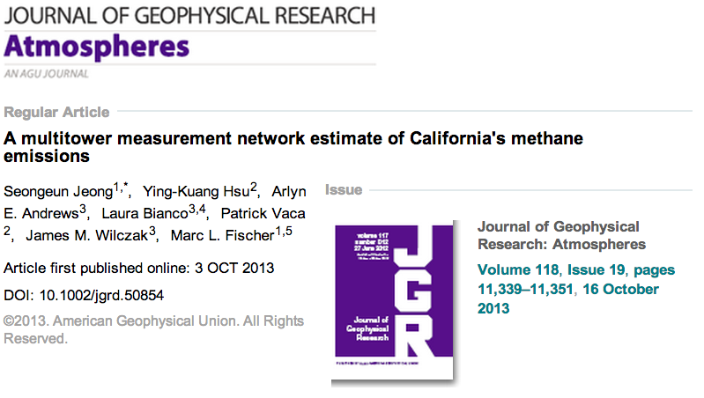
Recent studies have demonstrated the usefulness of regional Lagrangian inverse modeling for greenhouse gas flux estimation:

Slide 8
Recent studies have demonstrated the usefulness of regional Lagrangian inverse modeling for greenhouse gas flux estimation:
CarbonTracker-Lagrange is an effort to standardize these methods and provide up to date flux estimates. NOAA has the infrastructure to enable systematic comparison of different variants.

Slide 9
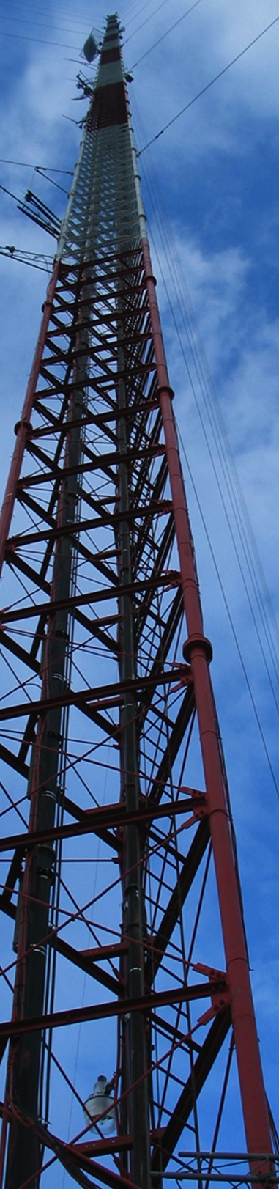
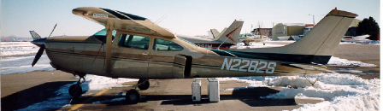
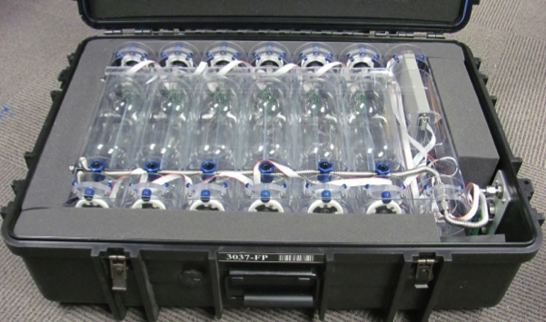
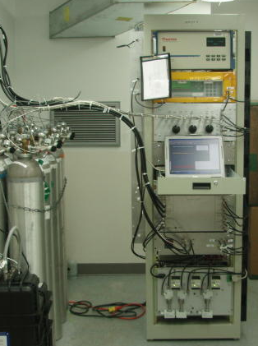
The North American Carbon Program +
PSU-Southeast Ring of Towers coming soon…
Lots of new data.
~50 sites online in Summer 2012 , (>100 by 2014)
Careful calibration necessary to ensure comparability across networks

Slide 10
  CarbonTracker-Lagrange Products
  Multi-laboratory CO₂ in situ data package (ObsPack)
  WRF Meteorological Simulations
    North America: 2007-2010, plans to extend through 2012, CMS 2014 will focus on 2015 (1st year of OCO2)
    Amazonia: 2011-2012, will include 2015
  Footprint Library
  Optimized CO₂ Fluxes, Optimized 4D Boundary/Initial Values, Posterior simulated CO₂ corresponding to observations. All with uncertainties.

Slide 11
AER WRF Simulations
CT-Lagrange North America 2008-2010 WRF domains (blue) with 1° footprint domain in red.
WRF simulations are allowed to evolve (version updates, increased vertical levels, domain changes etc.)

Slide 12
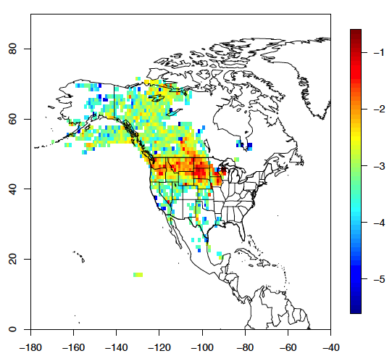
STILT Footprints
LEF Tower 396m: 2010-07-22 18:10
10-day footprints computed with 1°lat × 1° lon × hourly resolution
Second footprint computed with 1°lat × 1.25° lon × hourly for compatibility with NASA CMS and other NASA MERRA products
Nearfield footprint computed for subdomain with 0.1°lat × 0.1° lon × hourly for 24 hours
Particle trajectories archived as snapshots with decreasing frequency going backward in time
Convolutions with CarbonTracker and Goddard CASA-GFED3 (CMS) fluxes
All products archived in single Climate-Forecast Compliant NetCDF file (v4.0 with compression)

Slide 13
CarbonTracker-Lagrange: Footprint Library
  Species-independent footprints corresponding to > 1 million well-calibrated CO₂ in situ (continuous and discrete) measurements have been computed. Plans to extend through 2015.
  2007-2010
    Surface and tower sites with continuous CO₂ and CH₄ traceable to WMO scales maintained by NOAA/ESRL’s Global Monitoring Division. Eight footprints per day to resolve diurnal cycle, synched to solar 2 pm.
    Surface and aircraft flask samples from NOAA’s Global Greenhouse Gas Monitoring Network.
    North American TCCON sites. Two column simulations per day: (1) solar noon and (2) time of day corresponding to SZA = 70°
    GOSAT simulations for July 2009 – Dec 2010 were added with support from NASA’s Carbon Monitoring System.
  Summer 2012 Network Design Case Study
    Augmented surface network (new real and candidate future sites)
    Additional candidate TCCON sites
    OCO-2/ ASCENDS synthetic data
    Transport model comparisons
    Augmented aircraft network
red = CMS 2012
  Column-observations are simulated and stored as profiles. Footprints and boundary values from individual altitudes are weighted according to the retrieval averaging kernel and taking into account water vapor.

Slide 14
July 2010 Cumulative Sensitivity to Surface Flux for In Situ (Flask and Continuous) and ACOS GOSAT quality controlled data
Number of GOSAT observations is relatively low and sensitivity to surface fluxes is much lower than for in situ data
Increased sensitivity for column data may be achieved by extending domain further over the Atlantic

Slide 15
CarbonTracker-Lagrange: Inverse Modeling
  Efficient algorithm uses sparse matrix methods for explicit matrix inversion (Yadav and Michalak, Geosci. Model Dev., 6, 583-590, 2013). Computational speed enables many permutations of the inversion, such as:
    Multiple data-weighting scenarios
    Varied mathematical construct
      Form of state vector
      Bayesian or Geostatistical optimization
    Multiple priors
  Modular python software enables fast incorporation of new techniques and facilitates use of multiple transport models.
  New boundary value optimization capability has been implemented and is undergoing testing. Success requires vertically resolved measurements that are differently sensitive to surface flux and boundary errors (e.g. aircraft profiles, or surface plus column).
  Initial focus is on continental-scale CO₂ and CH₄ inversions for North America, with plans to move to finer spatial scales and simulate additional species.

Slide 16
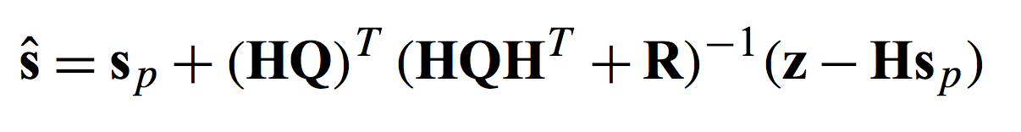
CarbonTracker-Lagrange Inversion Framework
Yadav and Michalak, Geosci. Model Dev., 6, 583–590, 2013
H is atmospheric transport operator (i.e. the footprints)
Q is the prior error covariance matrix
R is the model-data mismatch matrix
s_{p} is a vector containing the prior flux estimate
ŝ is a vector containing the revised fluxes
Modified framework for boundary optimization:
H has additional columns for boundary value grid cells
s_{p} and ŝ contains additional elements
Q contains additional rows and columns. No cross-correlation between boundary values and fluxes

Slide 17
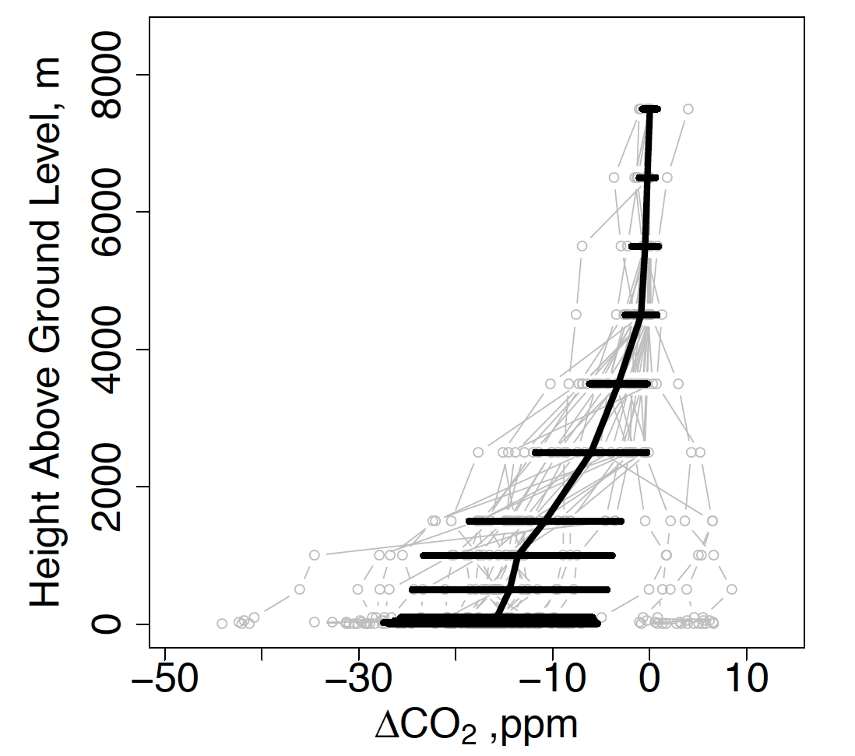
Data constraints on Boundary and Surface Influences:
CarbonTracker-Lagrange profiles corresponding to the Park Falls NOAA/UWI WLEF-TV Tall Tower and TCCON site
CASAGFEDCMS Net Ecosystem Exchange
1-31 July 2010, 14:00 LST
Contrast between surface and free troposphere data provides information about surface versus boundary influences.
Dense aircraft plus tall tower data is best, but bias-free column datasets could also provide a useful constraint.
Daily Profiles
Monthly Mean
CASAGFEDCMS fluxes courtesy of G. J. Collatz

Slide 18
July 2010 Synthetic Data Inversion; Monthly Mean Fluxes
Idealized case: perfect transport, perfect observations (no noise), no boundary value errors
Including GOSAT ACOS observations does not significantly change results

Slide 19
July 2010 Synthetic Data Inversion; ACOS GOSAT Residuals
Prior Simulated OBS – CASA OBS
mean=0.28
sd=0.68
Q16=-0.2
Q50=0.14
Q84=0.83
N=2623
Despite similarity of posterior fluxes with and without GOSAT ACOS observations, improvement in residuals is evident.
Posterior Simulated OBS – CASA OBS
mean=0
sd=0.2
Q16=-0.14
Q50=0
Q84=0.16

Slide 20
Status
Project will continue as Andrews CMS-2014 (see poster)
In situ and column footprints for 2007 -2010 and Summer 2012 available by FTP from NOAA/ESRL within one month
Inversion code fully functional with new boundary value optimization capability
Optimized fluxes and boundary values for 2007-2010 coming soon and will be compared with CMS flux products
Inversions will be done with and without ACOS GOSAT retrievals to investigate consistency of in situ and GOSAT observations

Slide 21
Additional Slides

Slide 22
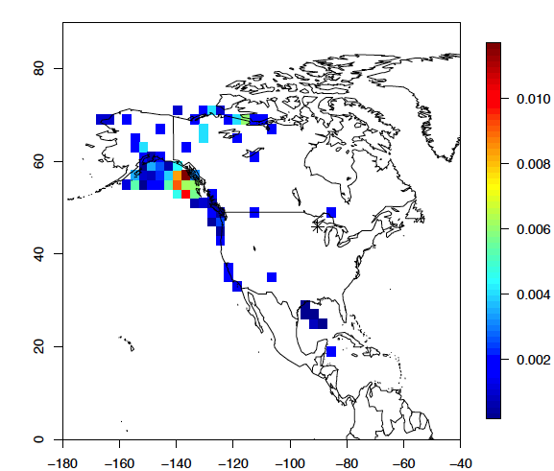
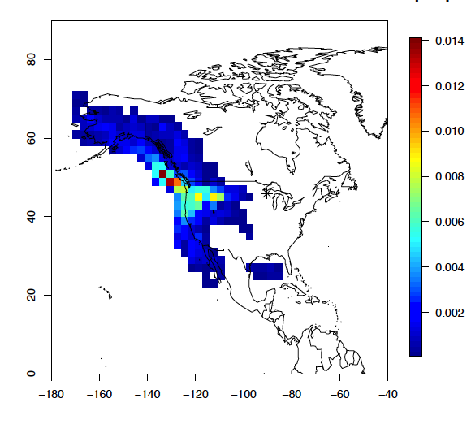
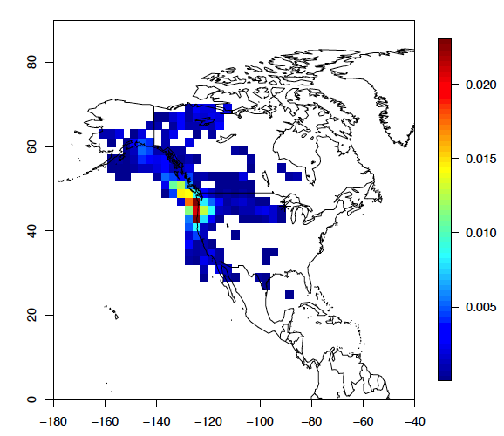
LEF Tower 396m: 2010-07-22 18:10
PBL: 0 – 2 km asl
Free Trop: 4 – 8 km asl
Gridded boundary footprints: Use all trajectory points within the mole fraction estimation domain.
Resolution: daily x 3 lon x 2 lat x three vertical bins.
Each trajectory gets 1/500th of the weight, but trajectories may have different number of points included.
Units are ppm per ppm.
Transition: 2 – 4 km asl

Slide 23
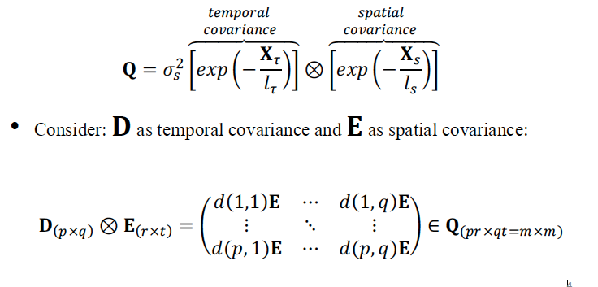
Prior Error Covariance Q
Yadav and Michalak, GMD, 2013:

Slide 24
We have generalized to allow space- and time-varying sigma:
I_{σ} is the diagonal matrix of standard deviations: I_{σ}[ij]=σ_{i} for i=j, 0 for i≠j.
Beta algorithm (in testing) that leverages Yadav and Michalak framework to avoid building full Q and full .

Slide 25
Model-Data Mismatch Matrix R
Many studies assume R varies slowly, e.g., assigned site by site with a seasonal cycle but no day to day or within day variability
CT-L bottom up model for R informed by:
  standard deviation for each observation (e.g. does measurement occur during or proximal to a frontal passage, wind shift, etc.)
  Modeled and/or measured vertical gradient information
  Proximity to flux gradients (e.g. coastlines, urban areas)
  Complex terrain
So far no off-diagonal elements

Slide 26
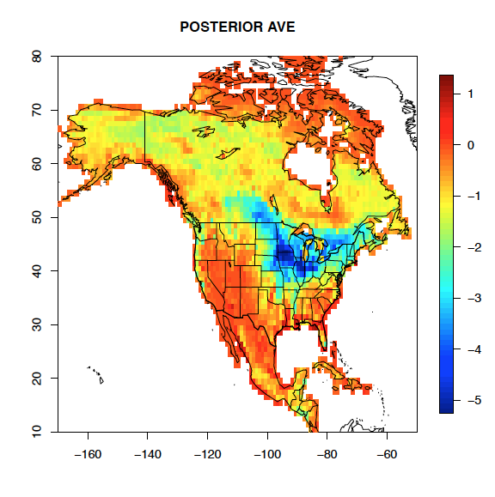
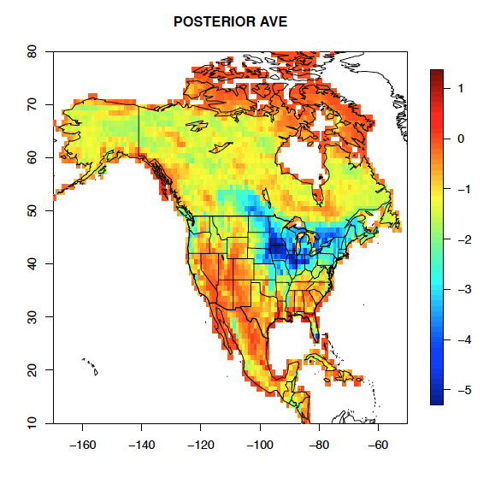
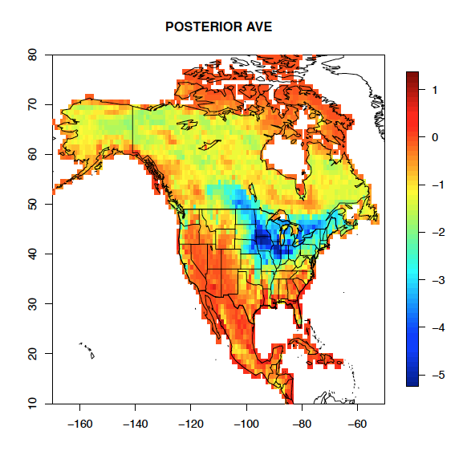
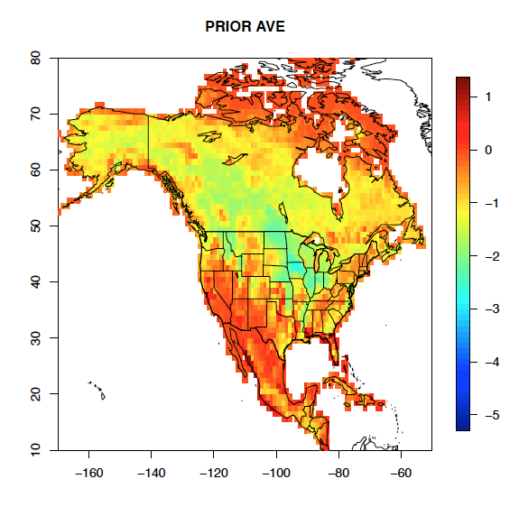
No Boundary Error
Boundary Error
No Boundary Optimization
Boundary Error
With Boundary Optimization

Slide 27
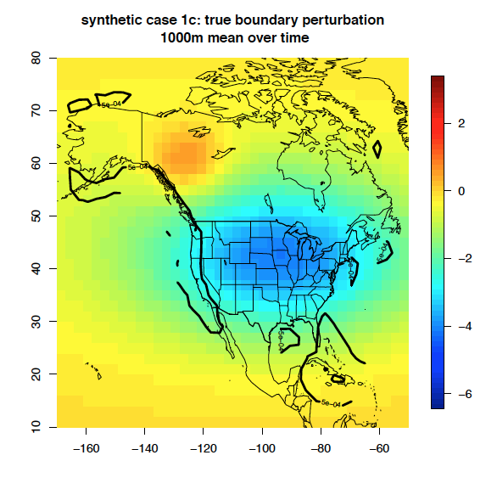
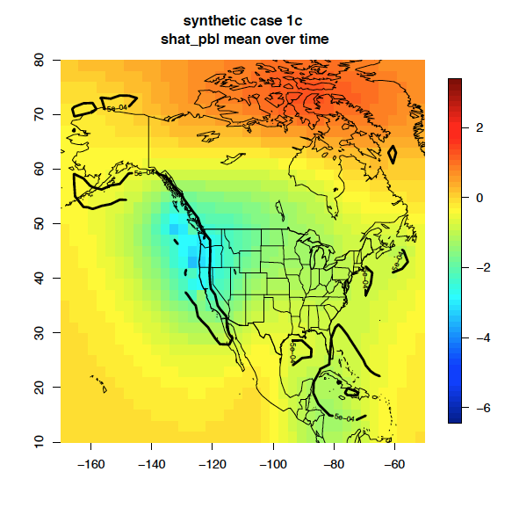
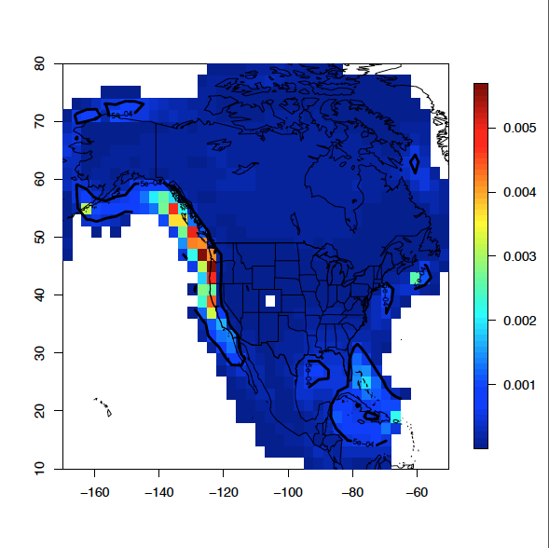
Free Troposphere Boundary Correction
TRUTH
POSTERIOR
PBL boundary influence

Slide 28
CarbonTracker-Lagrange profiles corresponding to Park Falls, WI:
Impact of surface fluxes minimal above 3000m
CASA/GSFC versus CT-2011oi NEE differences subtle
Sporadic fire influence aloft.
Small fossil fuel signal.
CASA/GSFC fluxes courtesy of G. J. Collatz
CarbonTracker fluxes courtesy of A. Jacobson
1-31 July 2010, 14:00 LST
Daily Profiles
Monthly Mean

